Slide 1


Delivered By: Group A-6 7th Sem CE(A) Under Guidance of: Prof. H. S. Belsare Assistant Professor Department of Computer Engineering Bapurao Deshmukh College of Engineering, Sewagram Academic Year : 2023-24
Project Phase -1
Enhanced Free VPN Service with Advanced Security and Performance Features

Slide 2
Contents
Introduction
Objectives
Literature Review
Flowchart
Progress
Reference

Slide 3
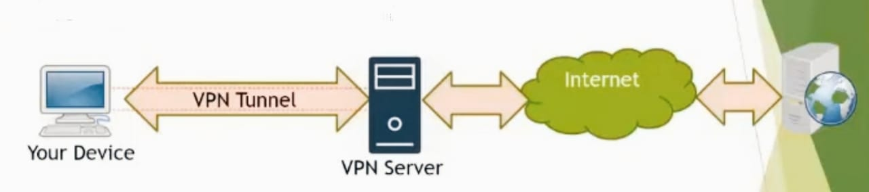
Introduction
What is VPN ?
A VPN stand for the Virtual Private Network.
VPN is a secure tunnel between your device and the internet Or
Between two private networks connected on internet.

Slide 4
Introduction
Uses of VPN
Online privacy
Security
Anonymous Browsing
Torrenting and File Sharing
Avoid Bandwidth Throttling
Secure Communication

Slide 5
Objectives of Project Work
To develop a user-friendly VPN application using Flutter, REST APIs
To develop open VPN protocol.
To optimize performance for seamless browsing experiences on various devices.
To bridge the gap between free and premium VPN services and offering accessible and secure online privacy solutions.

Slide 6
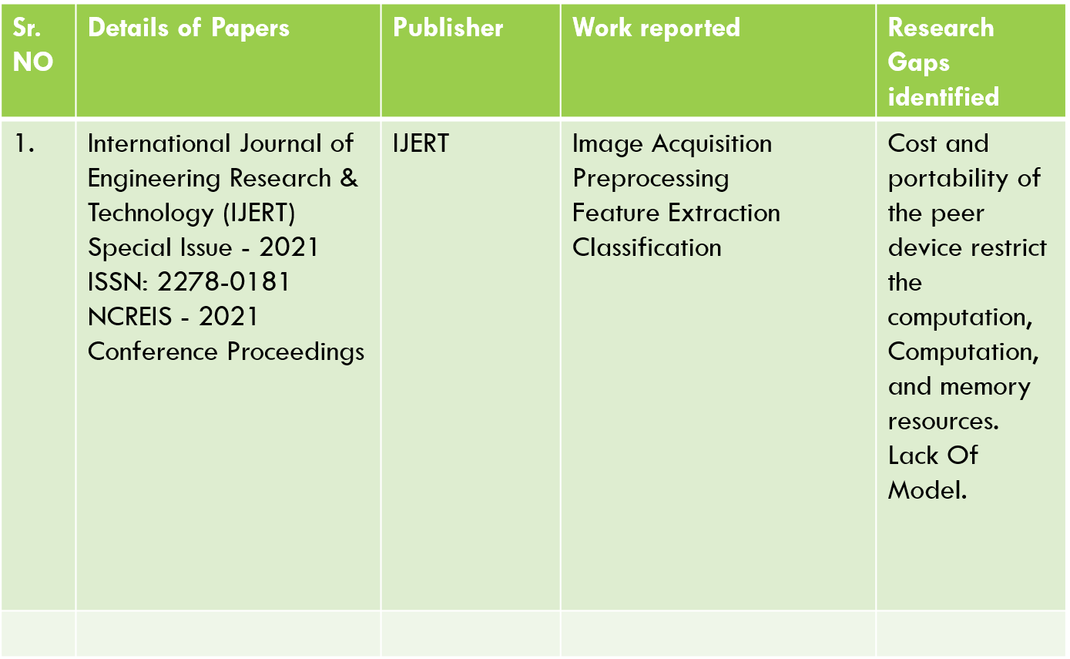
Literature Review
Sr. NO | Details of Papers | Publisher | Work reported | Research Gaps identified
1. 2. | Analysis of Security Virtual Private Network (VPN) Using OpenVPN, 2022 “Virtual Private Network: A Study of its Various Aspects”, presented by NIC MP Officers in IEEE International Conference (ICICAT- 2023) | Research Gate ICICAT-2023 | Reports on how the use of VPN is promoted to enhance data secure transfer with integrity and confidentially. | High cost of VPN services for the user Due to this less usage of VPN for the general user.

Slide 7
Flowchart
Start
Identify Current VPN Features
Security Analysis
Feature Enhancement Planning
Testing And Evaluation
Security Feature Implementation
Feedback Collection
User Experience Enhancement
End

Slide 8
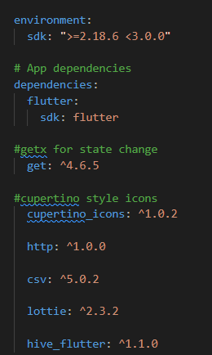
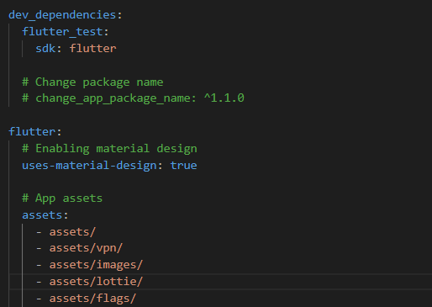
pubspec.yaml(dependencies)

Slide 9
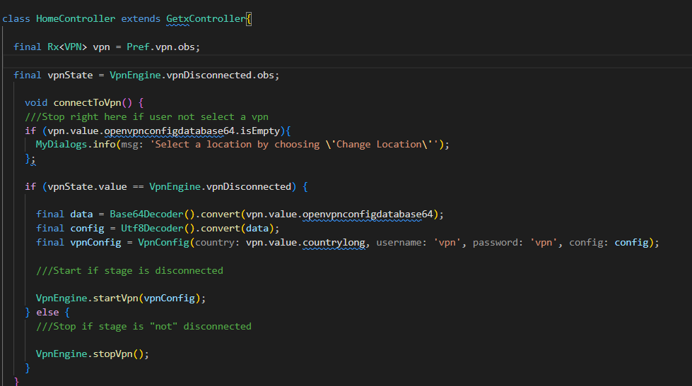
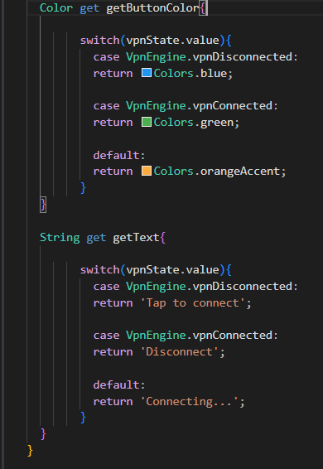
Home Controller
Base 64 to string conversion

Slide 10
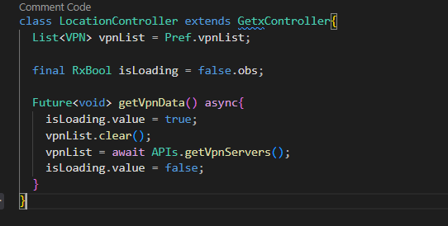
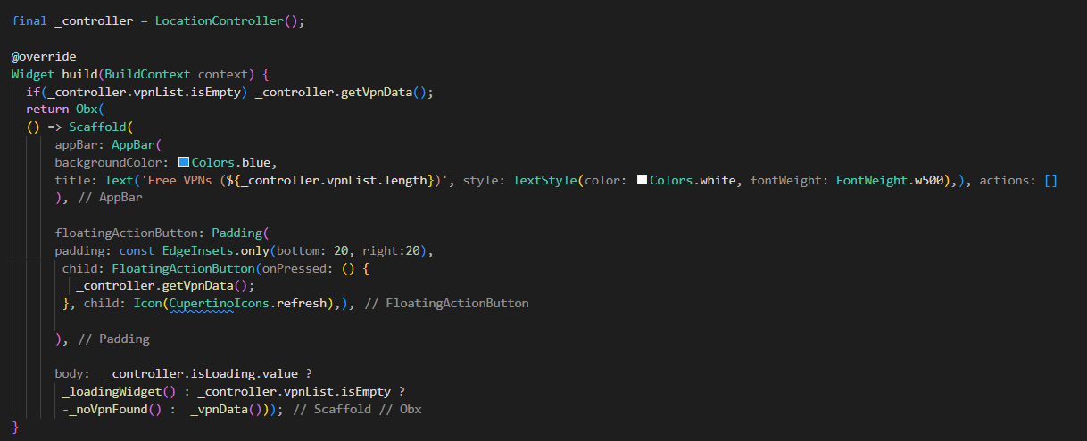
Location Controller

Slide 11
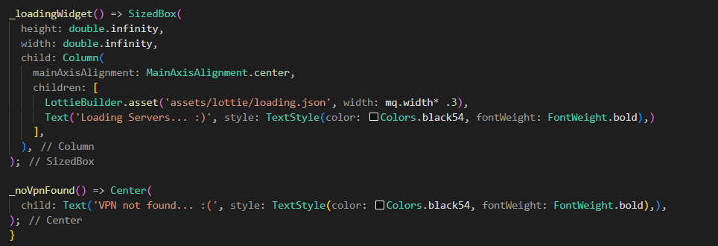
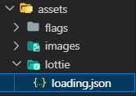
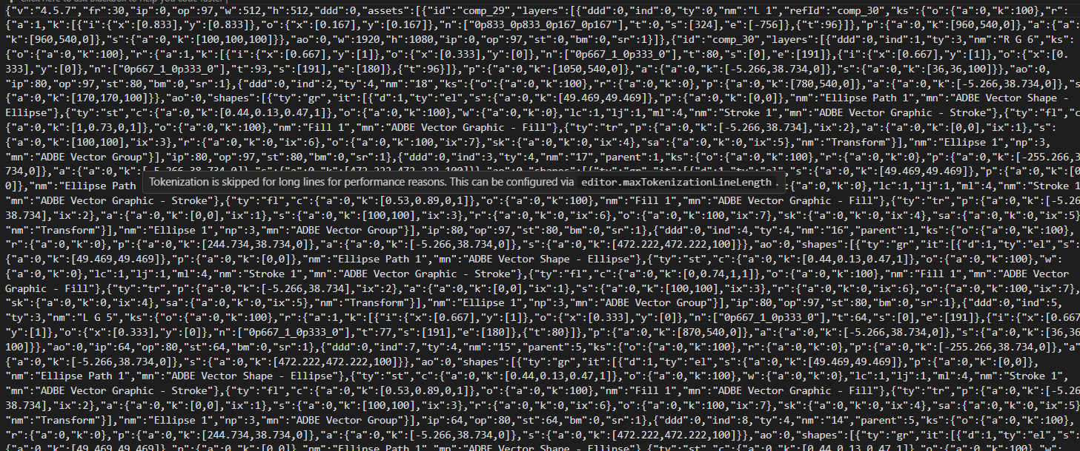
Lottie Animations

Slide 12

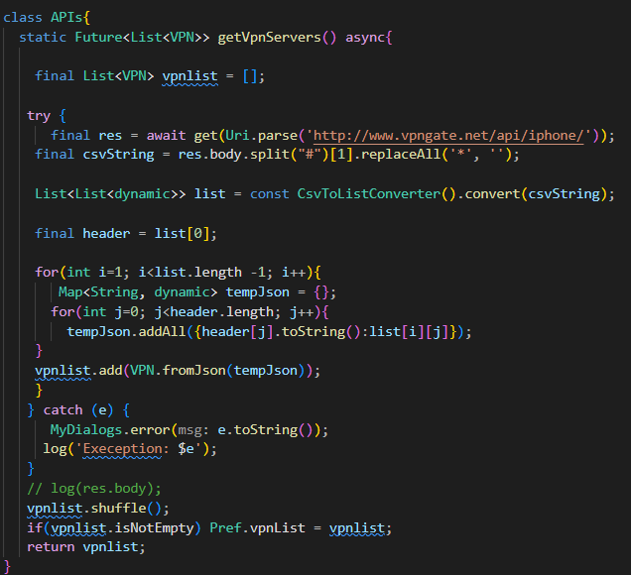
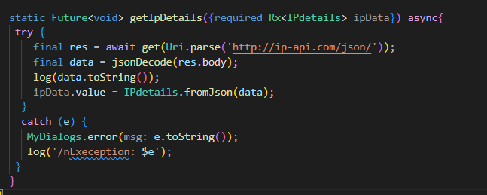
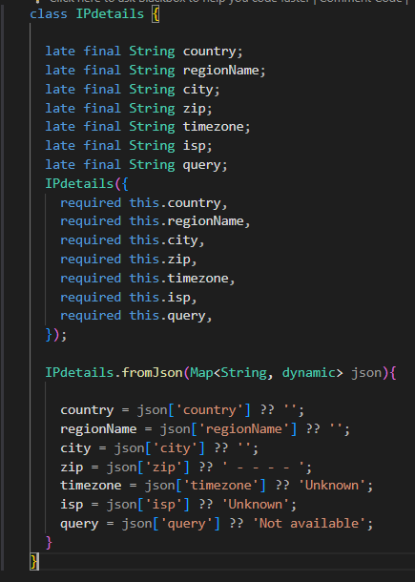
Api.dart

Slide 13
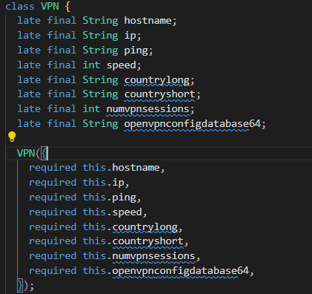
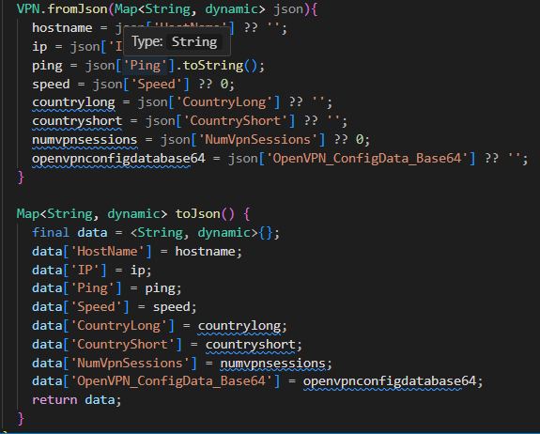
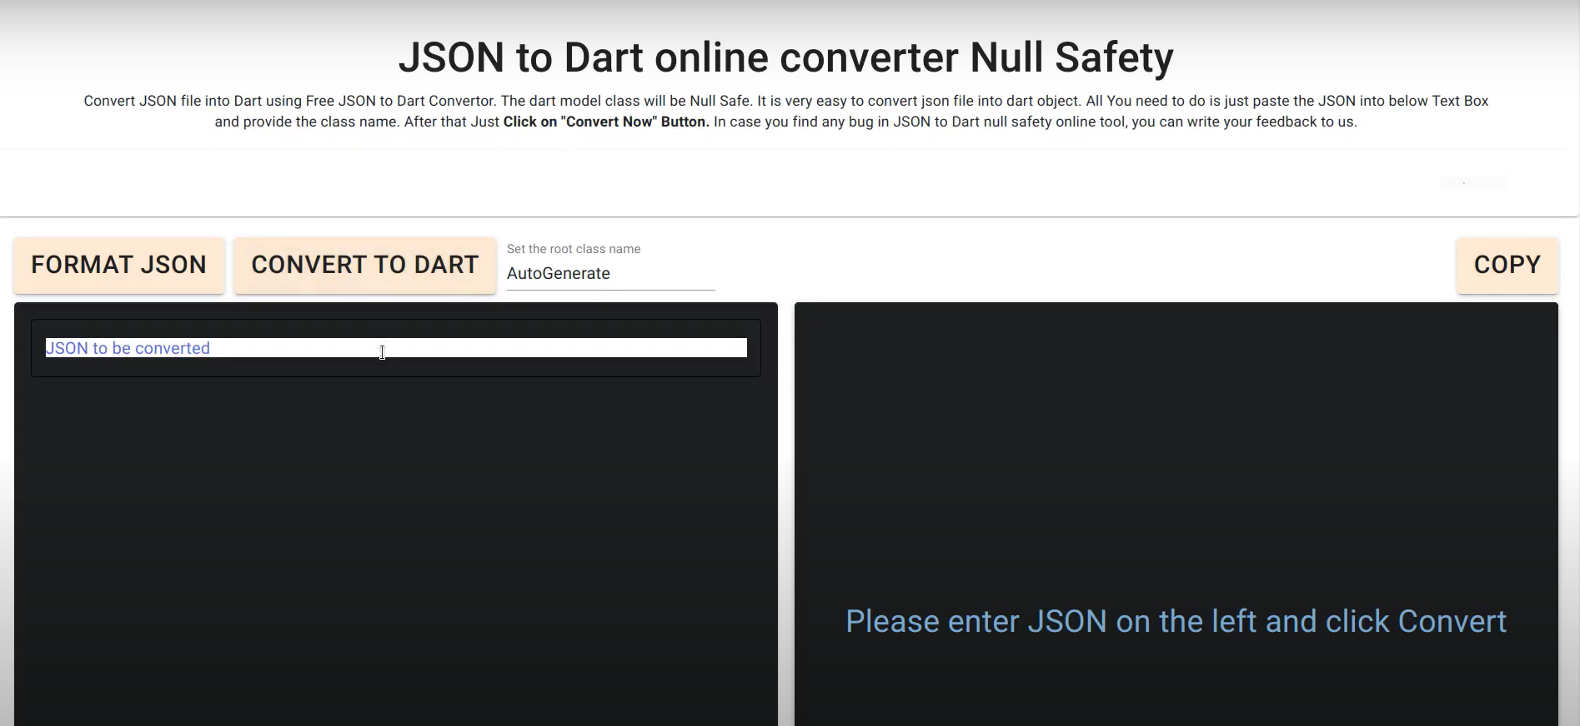
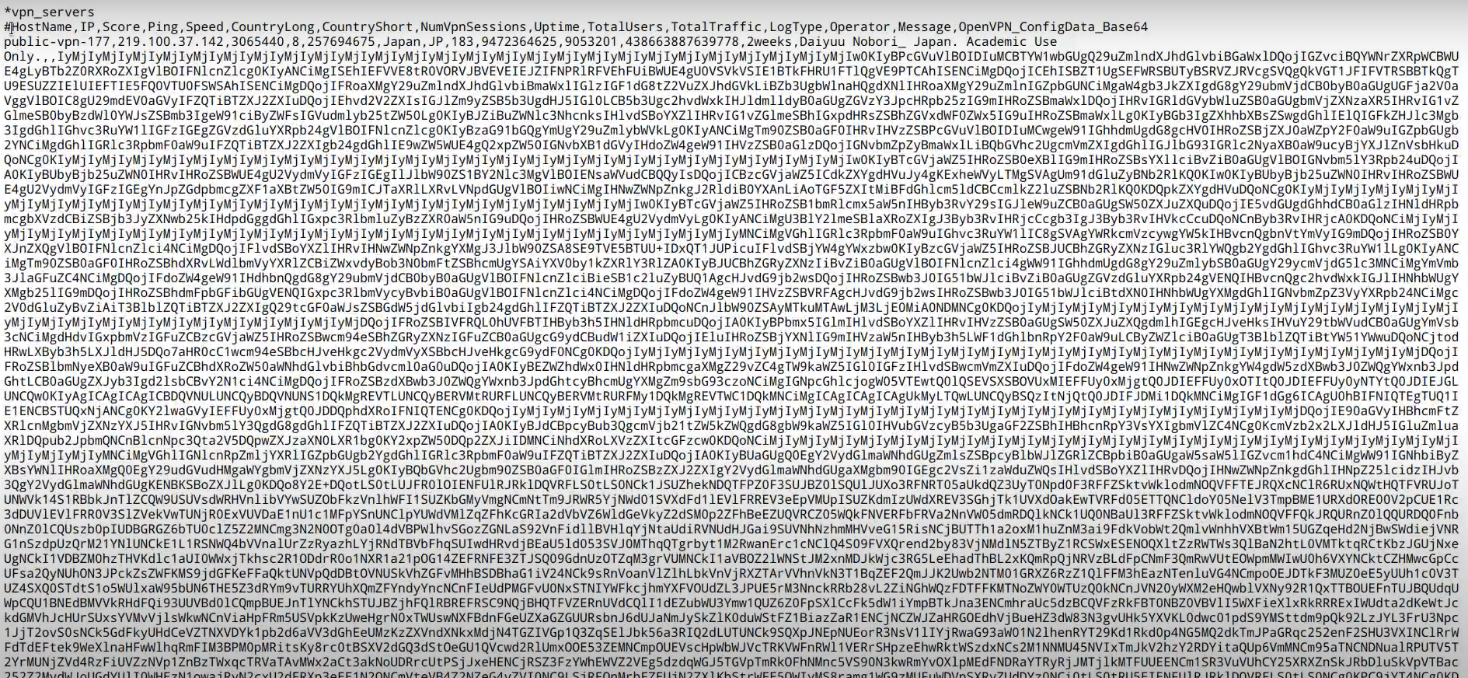
Converting csv to json file

Slide 14
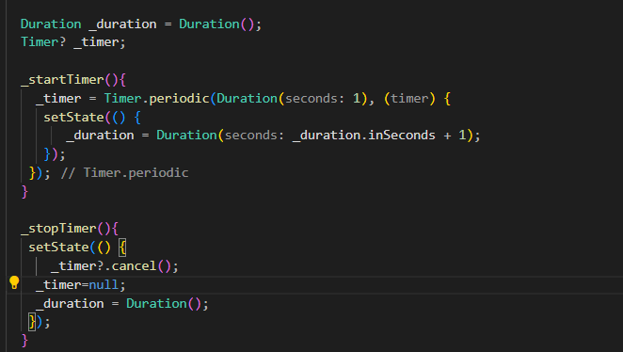
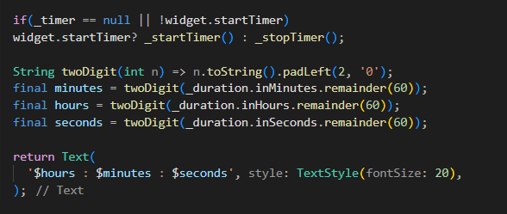
Timer

Slide 15
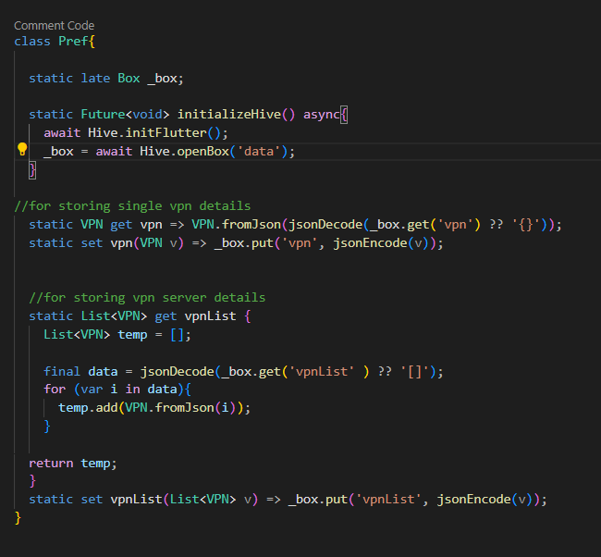
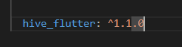
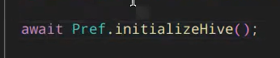
Hive Database(For cache storage)
Called in main.dart

Slide 16
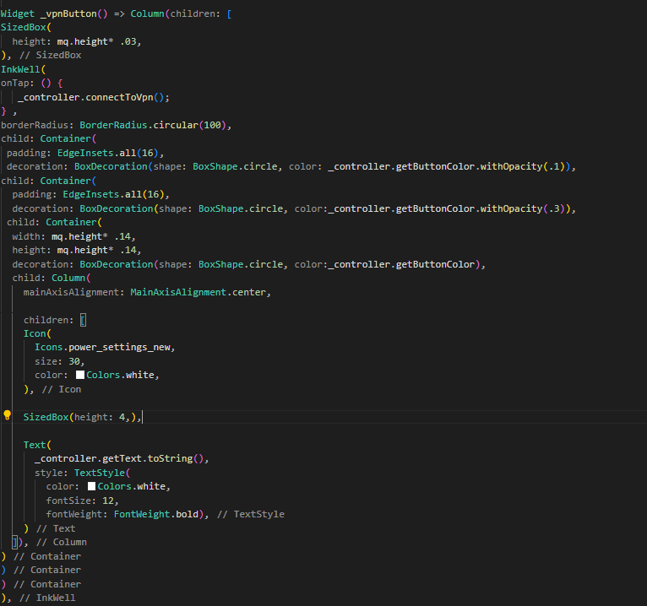
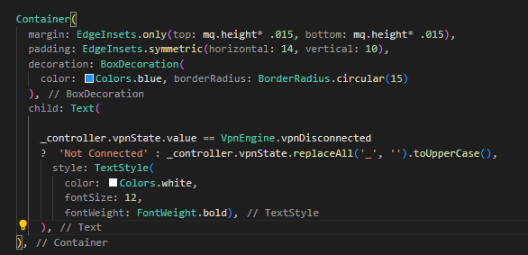
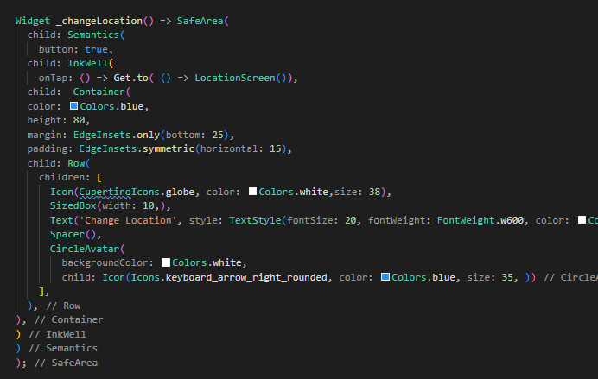
Home Screen
State
VPN Button
Location Navigator

Slide 17
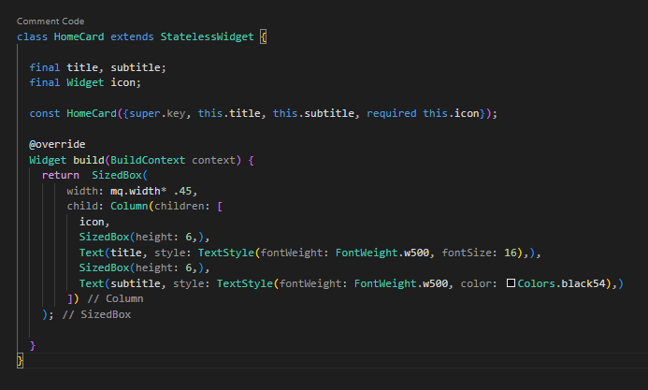
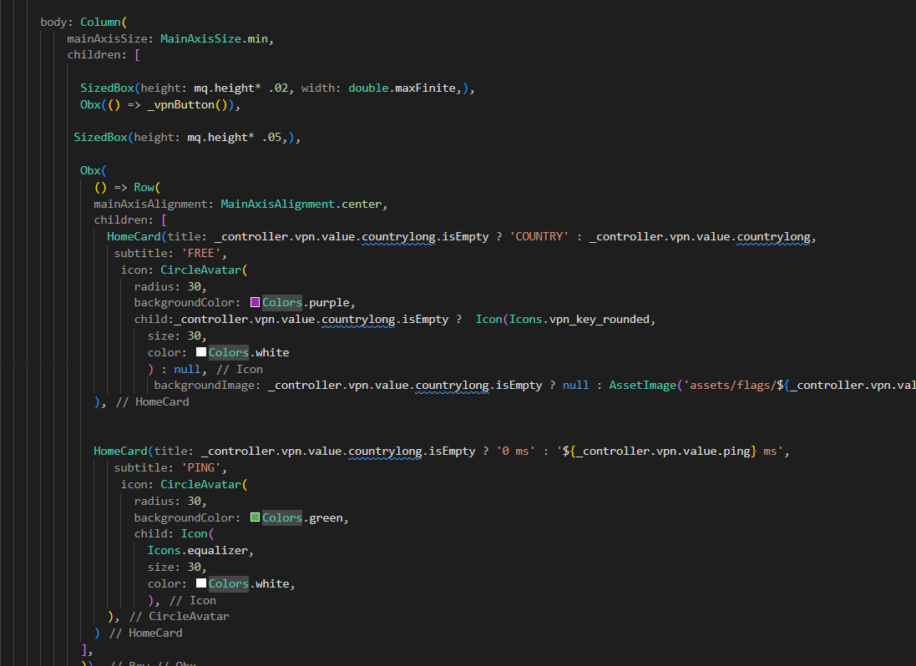
Home Screen-2

Slide 18
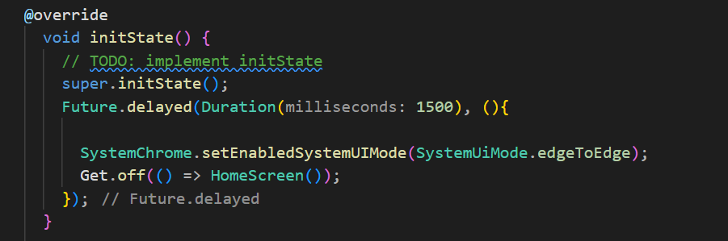
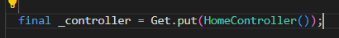
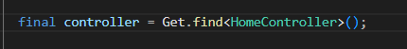
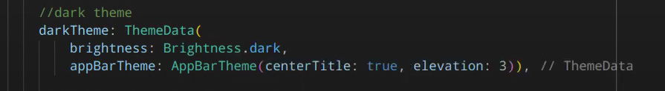
Light Theme/Dark Theme:
Getx usage:
Same controller can be used in different positions in the code

Slide 19
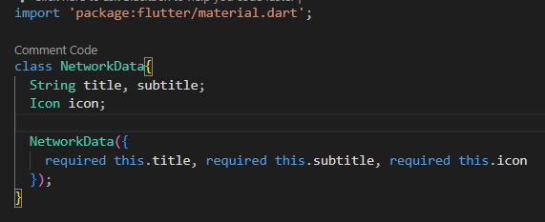
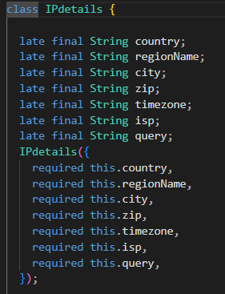
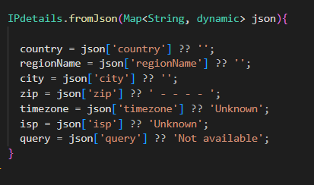
Network Card/ ip details.dart

Slide 20
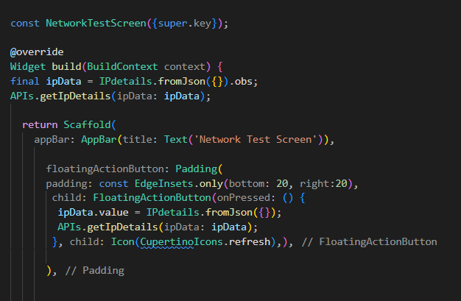
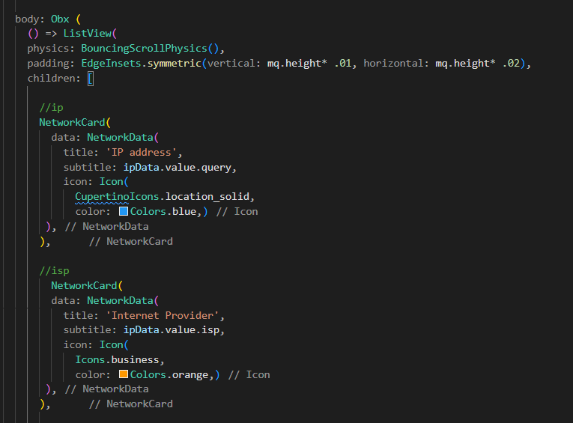
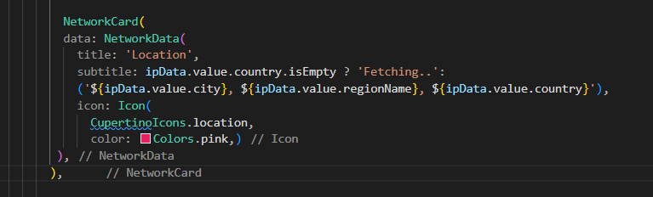
Network Test Screen

Slide 21
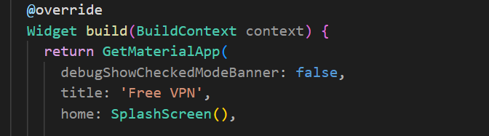
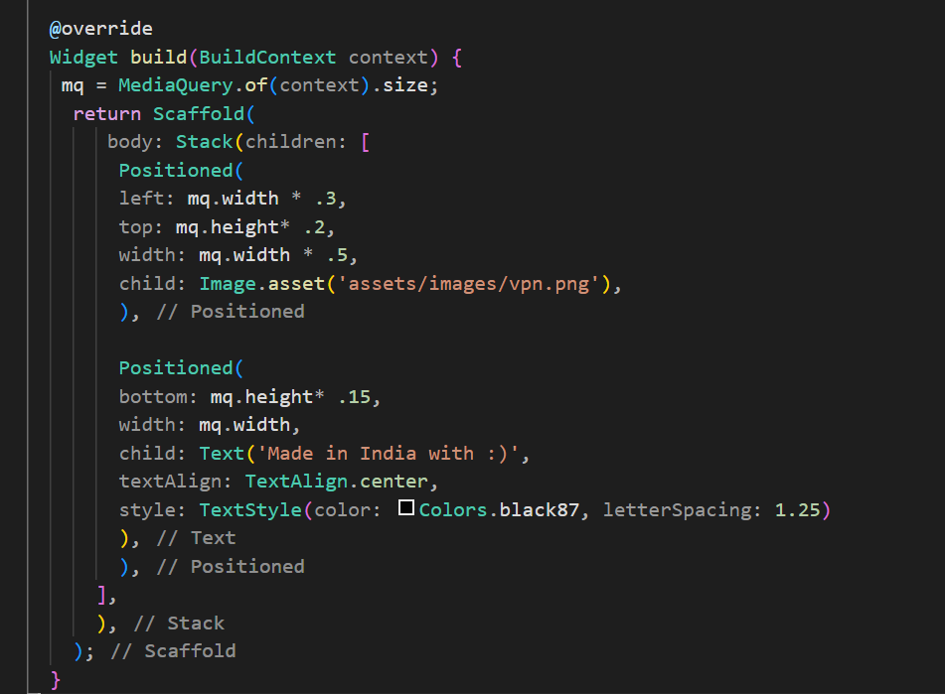
Splash Screen

Slide 22

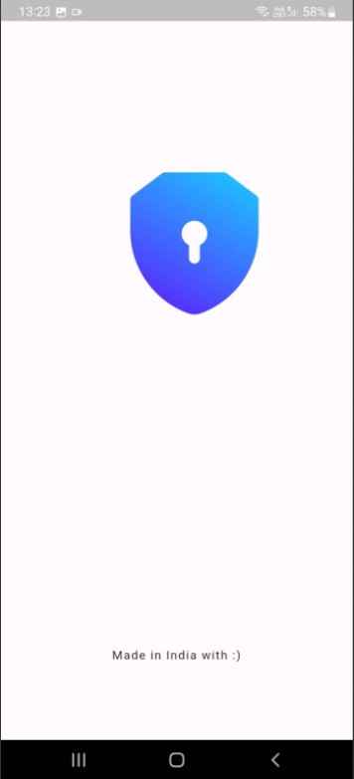
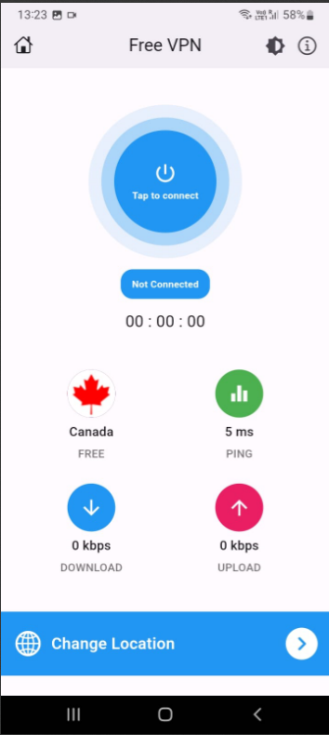
Result

Slide 23
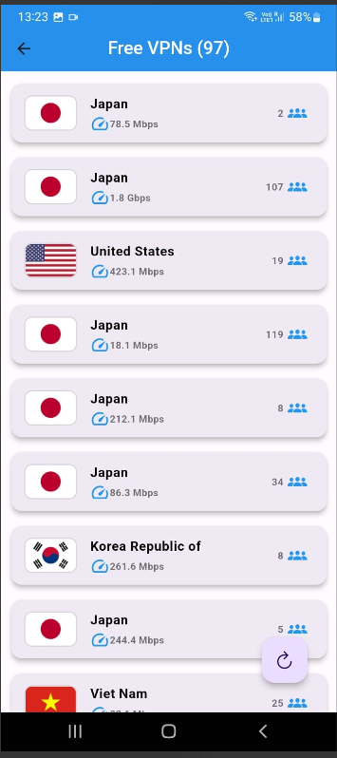
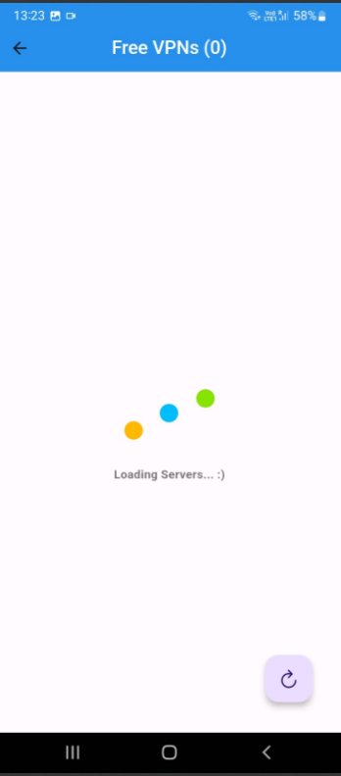
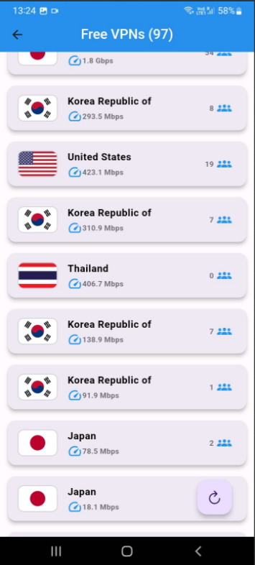
Result

Slide 24
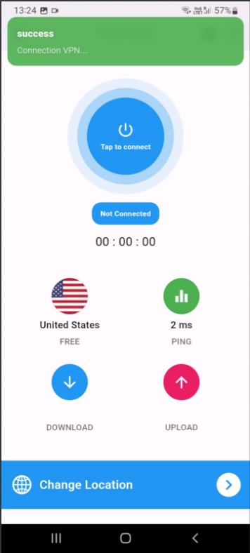
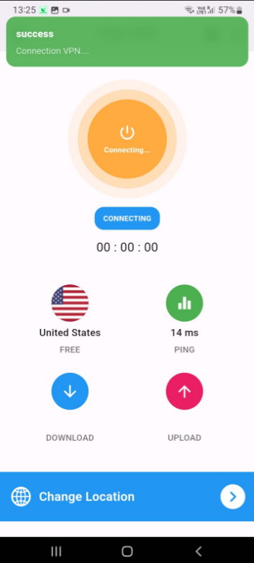
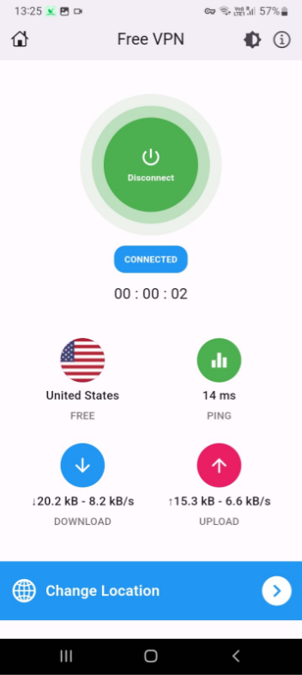
Result

Slide 25
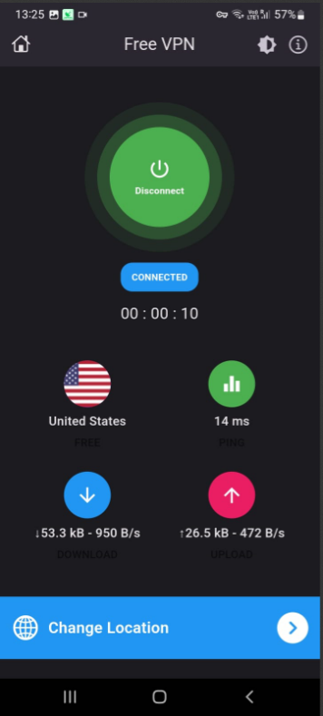
Result

Slide 26
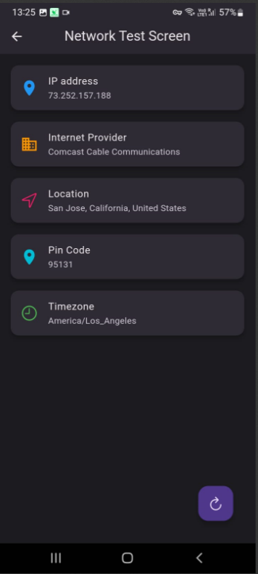


Result

Slide 27



Result

Slide 28
References
X. Zhiwei and N. Jie, "Research on network security of VPN technology", Ieeexplore-ieee-org.proxy.mau.se, 2022.
Thomala, L. (2022). China: number of Facebook users 2023 | Statista, 18 February 2021.
Wilson, J., McLuskie, D., & Bayne, E. (2020). Investigation into the security and privacy of iOS VPN applications | Proceedings of the 15th International Conference on Availability, Reliability and Security, 18 February 2022.

Slide 29
Thank You

